Slide 1
Processing Considerations
Senior Design Team #5
Mike Case, Graeme Danforth, Brad Huber, Josh Minneti, Glen Nicholls
Customer: Anthony Andriano
Advisor: Leslie Tekamp
4/6/18

Slide 2
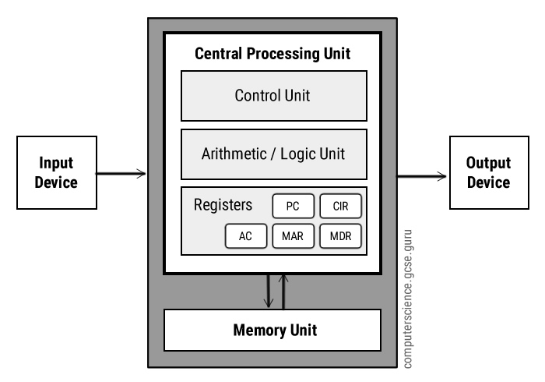
Von Neumann CPU

Slide 3
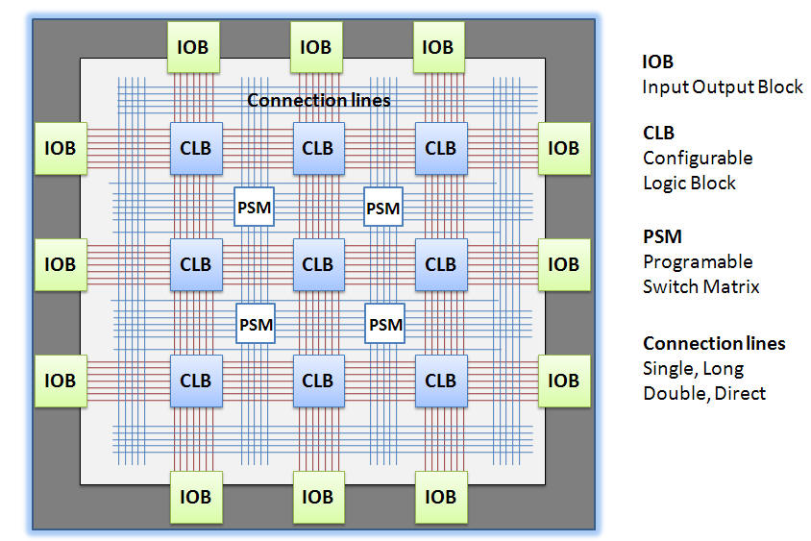
FPGA

Slide 4
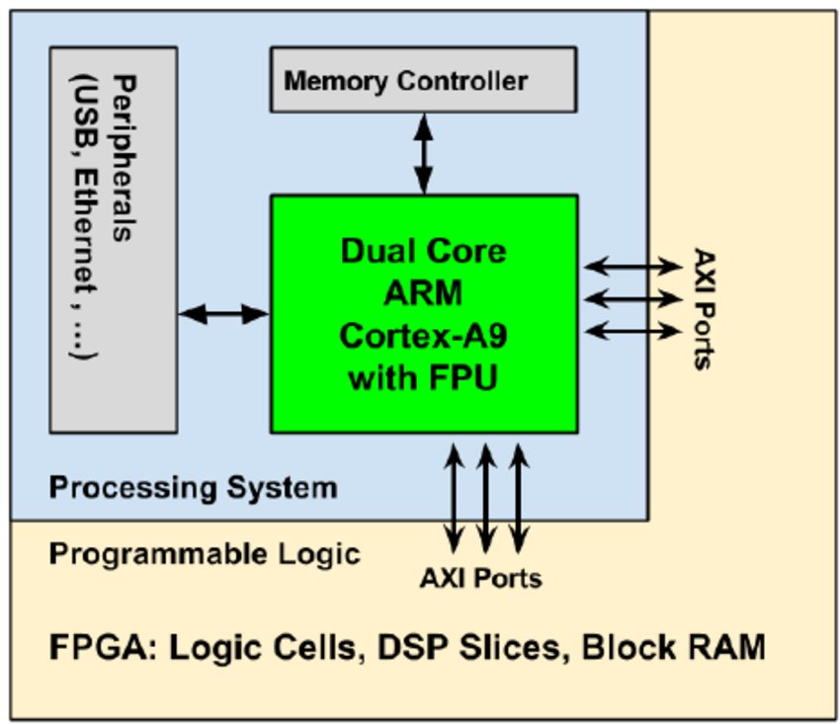
FPGA SoC/MPSoC

Slide 5
Software
Advantages
Easy to debug
Time to market
Open source tools
Disadvantages
Processing overhead (sequential)
Processing time can vary
Fixed hardware

Slide 6
Firmware (HDL)
Advantages
Highly parallelizable (real-time)
Low power (application specific)
“Infinitely” reconfigurable
Deterministic latency
Disadvantages
Harder to debug
Verification process
Slice/LE architecture is fixed
Much higher risk!

Slide 7
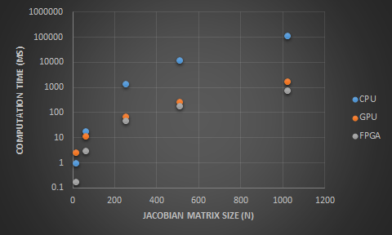
Speed: Jacobian Matrix

Slide 8
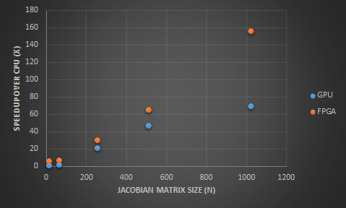
Speed: Jacobian Matrix

Slide 9
How are we going to track the sun?
(Option 1) Use GPS (Lat/Long) & NREL data to position solar panel.
(Option 2) Use a photo resistive array or light/UV sensor module to determine best pointing angle.
(Option 3) Use a camera and image processing to determine best pointing angle.
(Option 4) Use Option 1 with a fine positioning update from either Option 2 or 3.

Slide 10
How are we going to track the sun? (Option 1 – GPS and NREL data)
Will require use of position (Lat/Long) either predetermined or from a GPS module (~ $40).
Will require "knowing" panel position relative to the earth and sun (magnetometer and accelerometer module - combined ~ $15).
Will require use of NREL data for expected position. Closest data available is from about one mile away from customer's location.
No need for tracking light intensity.
Allows for many options for µC, µP or FPGA.
Allows for easy scalability, can be easily adapted to other systems.

Slide 11
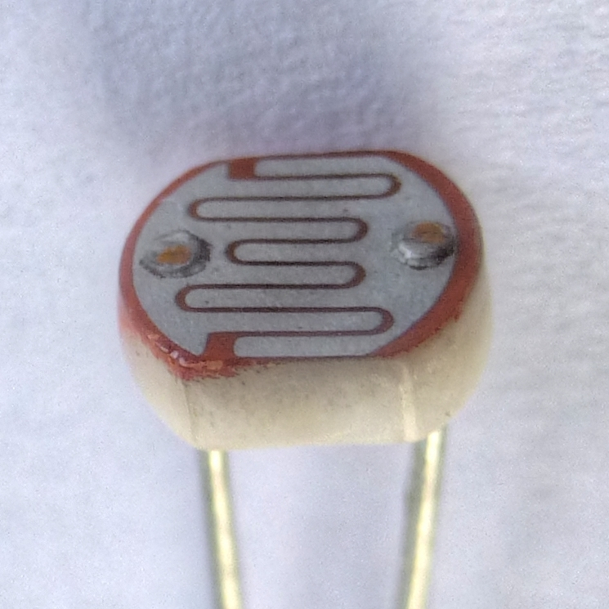

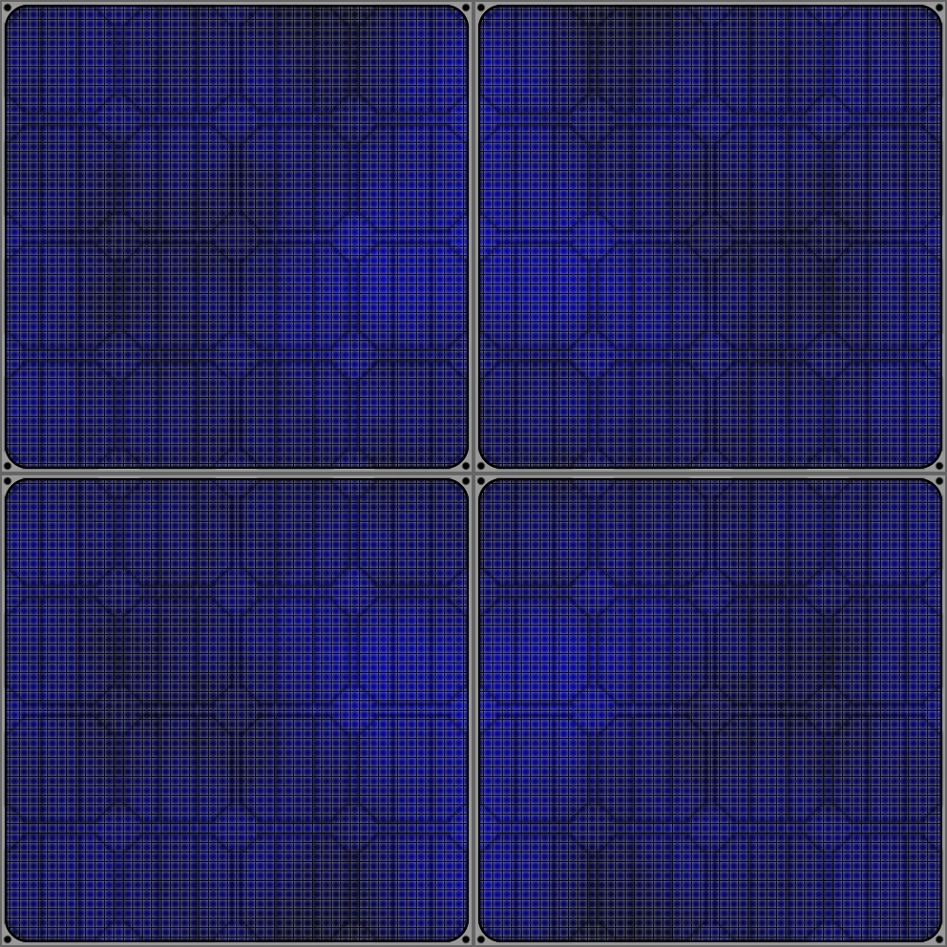
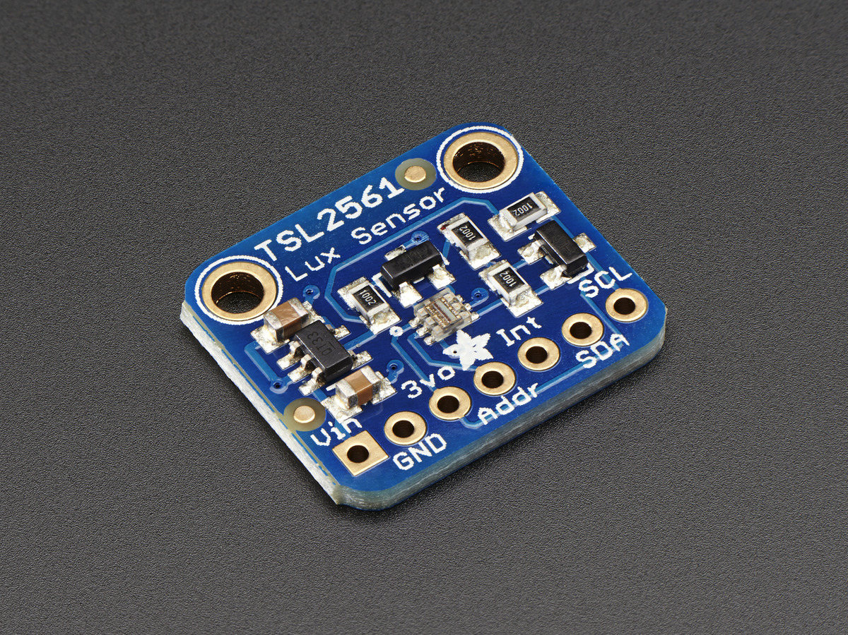
How are we going to track the sun? (Option 2 – Photoresistors or Light/UV Sensor)
Will require use of a photo resistive array (most likely four photoresistors ~$1 each) or a single digital light sensor module or UV sensor module (both ~ $6 and I2C).
Each photoresistor will require an Analog-to-Digital converter (ADC).
The µC, µP or FPGA will need to have enough ADC channels to support, or a separate ADC module will need to be used.
Notes:
https://qbicle.deviantart.com/art/solar-panel-texture-98103174
https://en.wikipedia.org/wiki/Photoresistor
https://www.adafruit.com/product/439

Slide 12
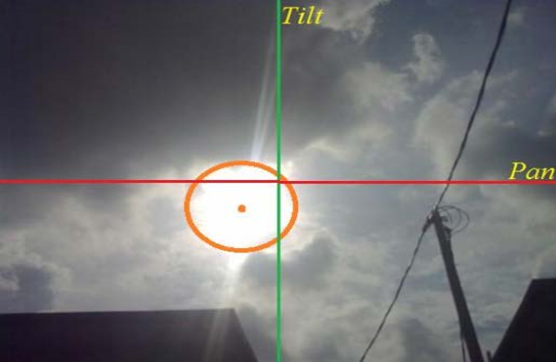
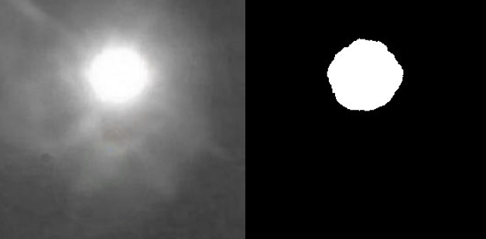
How are we going to track the sun? (Option 3 – Camera and Image Processing)
Will require the use of a camera module or USB camera (both starting at ~ $30).
Will require image processing, utilizing the OpenCV library.
More complex to implement.
Allows for many options for µP, possible for some µC, unlikely for FPGA.
Allows for easy adaptability between other PCs, µP, and cameras.
Notes:
www.jmest.org/wp-content/uploads/JMESTN42350280.pdf

Slide 13
How are we going to track the sun? (Option 4)
Will require implementing Option 1 and either Option 2 or 3.
More development time and cost.
Should be able to produce more accurate results and reduce power consumption.
Implementing two options will allow for a system back-up if one option should fail, increasing reliability of the overall system.

Slide 14
Next Steps
Develop cost vs. performance analysis model

